Slide 1
William Stallings Computer Organization and Architecture
6th Edition
Chapter 9
Computer Arithmetic

Slide 2
2.1 Introduction to Arithmetic and Logical unit, Computer Arithmetic: Fixed and Floating point numbers, Signed numbers, Integer Arithmetic, 2’s Complement arithmetic
2.2 Booth’s Recoding and Booth’s algorithm for signed multiplication, Restoring division and non-restoring division algorithms
2.3 IEEE floating point number representation and operations: Addition. Subtraction, Multiplication and Division. IEEE standards for Floating point representations :Single Precision and Double precision Format

Slide 3
Arithmetic & Logic Unit
Does the calculations
Everything else in the computer is there to service this unit
Handles integers
May handle floating point (real) numbers
May be separate FPU-floating-point unit (FPU), which operates on floating point numbers. (maths co-processor)

Slide 4
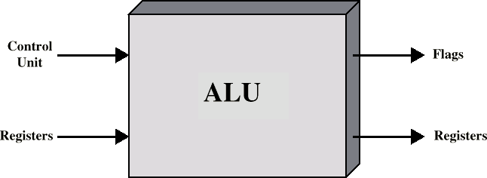
ALU Inputs and Outputs

Slide 5
Operands for arithmetic and logic operations are presented to the ALU in registers, and the results of an operation are stored in registers.
These registers are temporary storage locations within the processor that are connected by signal paths to the ALU.
The ALU may also set flags as the result of an operation.
The flag values are also stored in registers within the processor.
The processor provides signals that control the operation of the ALU and the movement of the data into and out of the ALU.

Slide 6
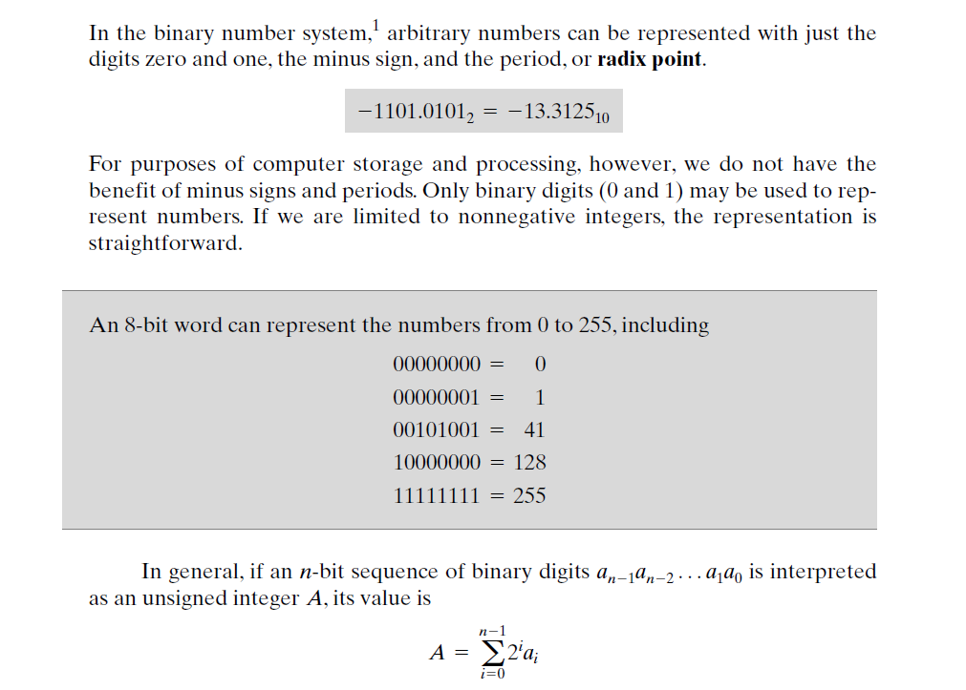
Integer representation

Slide 7
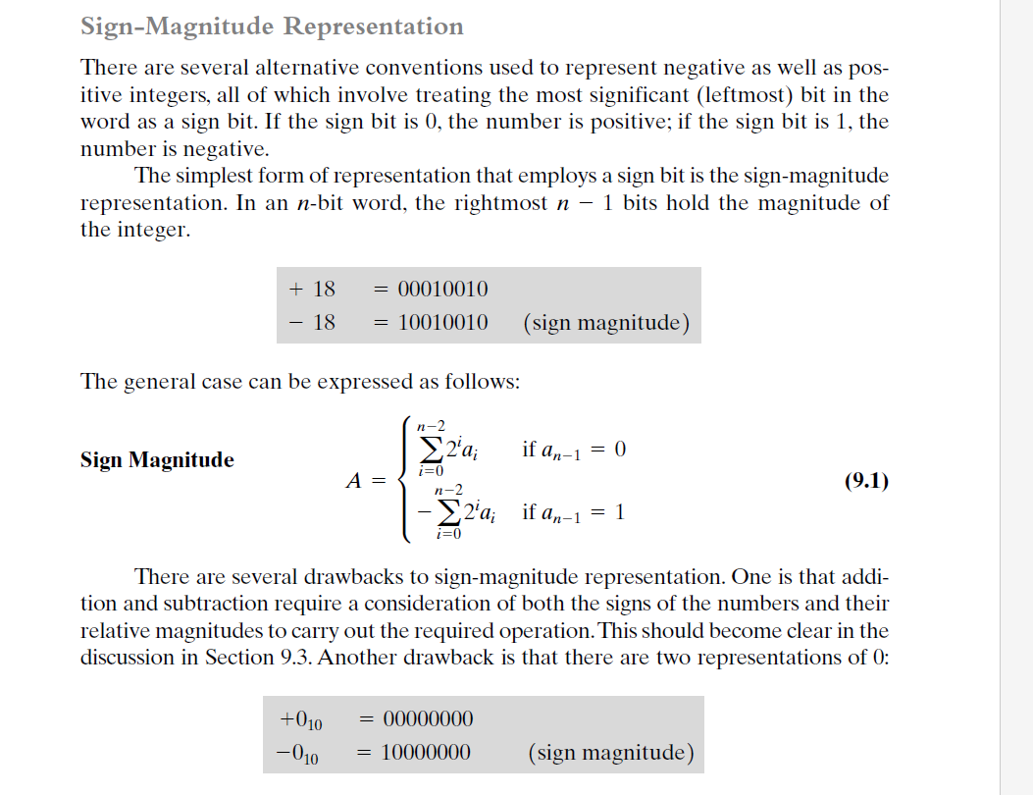

Slide 8
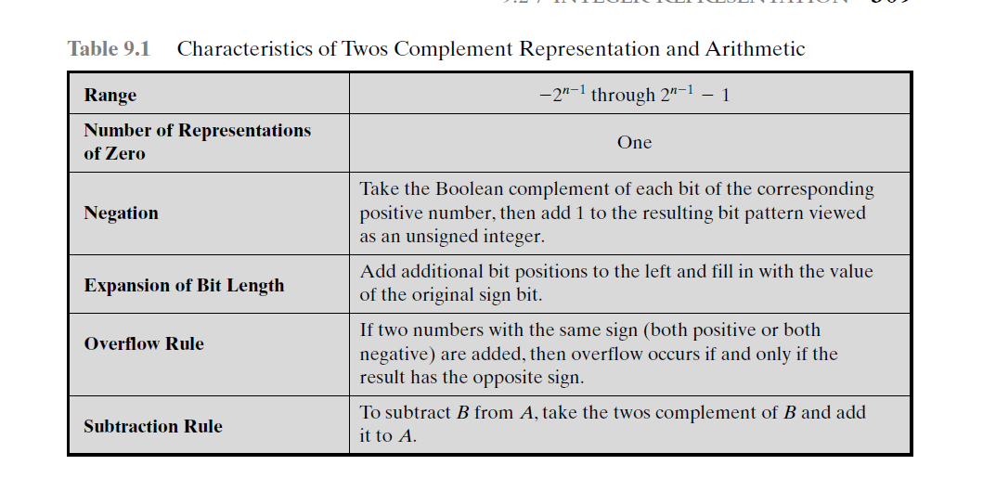
Twos Complement Representation
Like sign magnitude, twos complement representation uses the most significant bit
as a sign bit, making it easy to test whether an integer is positive or negative.
It differs from the use of the sign-magnitude representation in the way that the other bits are interpreted.
it facilitates the most important arithmetic operations, addition and subtraction. For this reason, it is almost universally used as the processor representation for integers

Slide 9

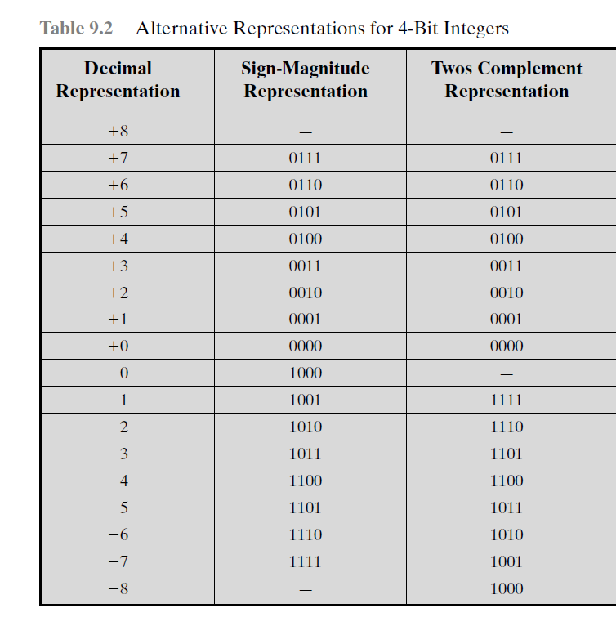

Slide 10
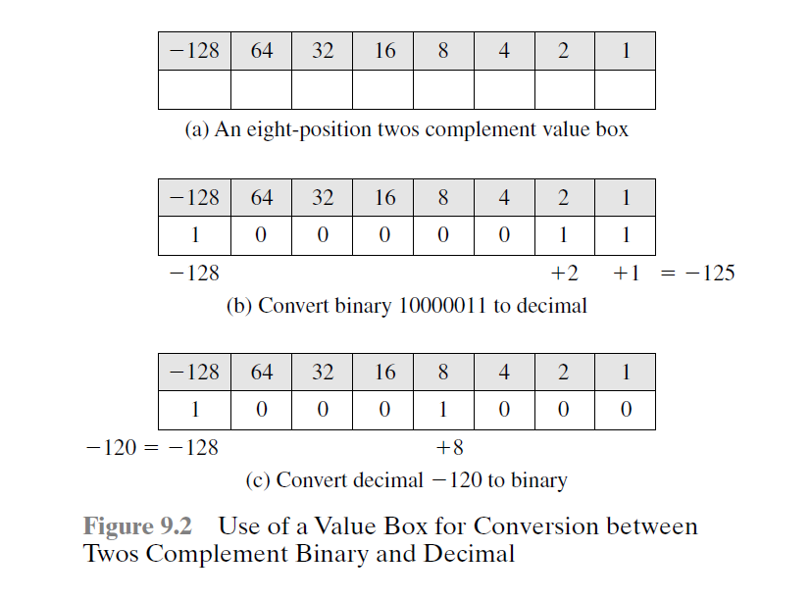

Slide 11
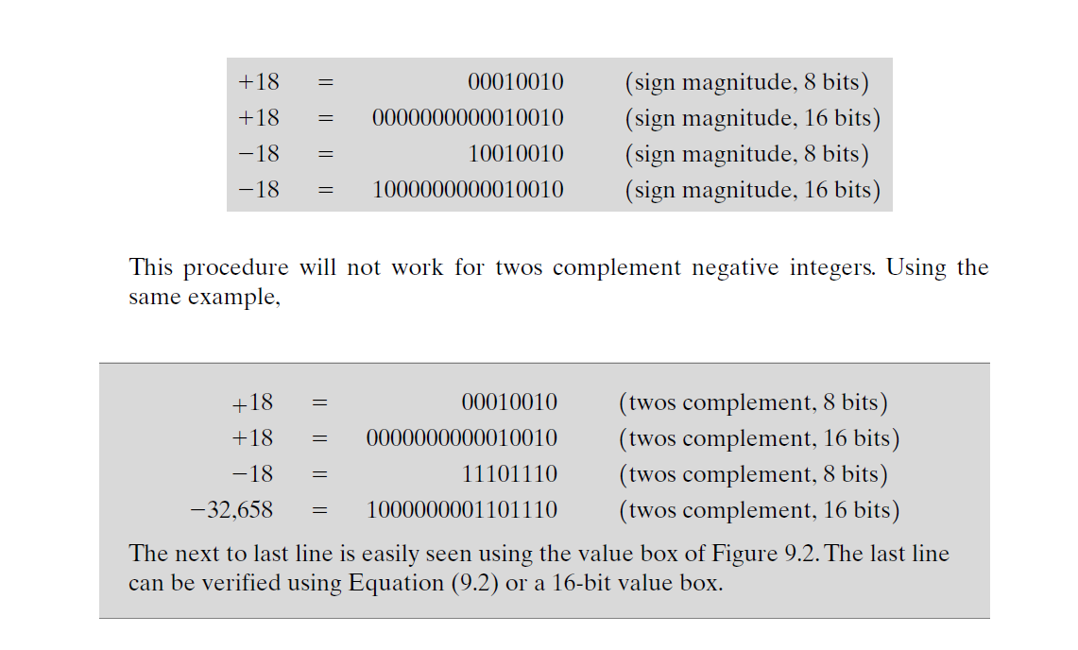

Slide 12
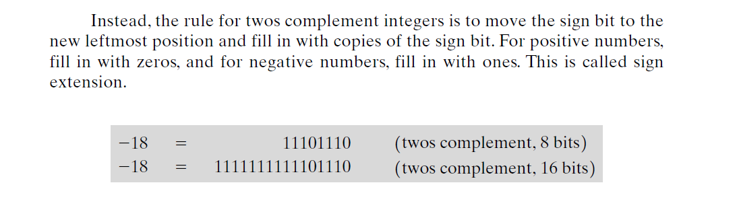

Slide 13
Fixed point representation
the radix point (binary point) is fixed and assumed to be to the right of the rightmost digit.
The programmer can use the same representation for binary fractions by scaling the numbers so that the binary point is implicitly positioned at some other location.

Slide 14
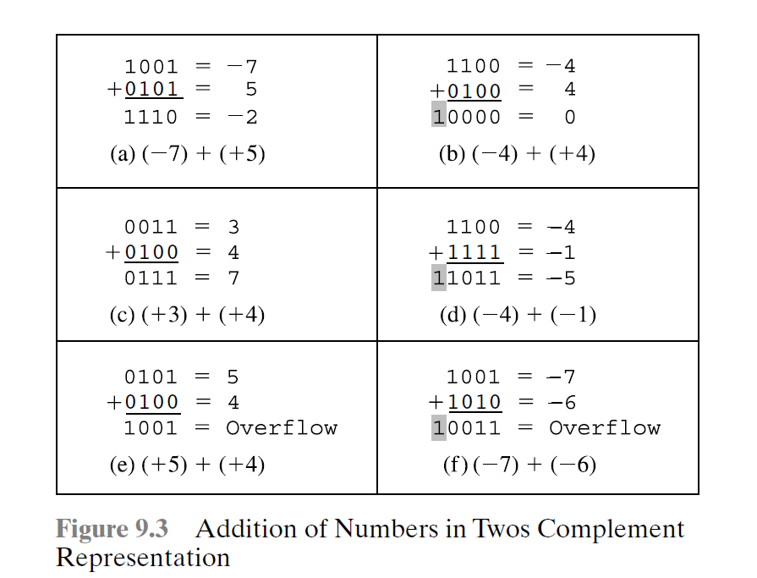
Addition and Subtraction

Slide 15
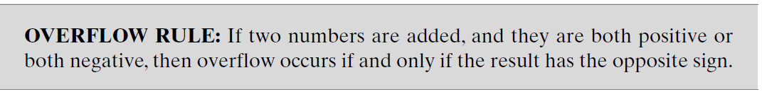
On any addition, the result may be larger than can be held in the word size
being used. This condition is called overflow

Slide 16
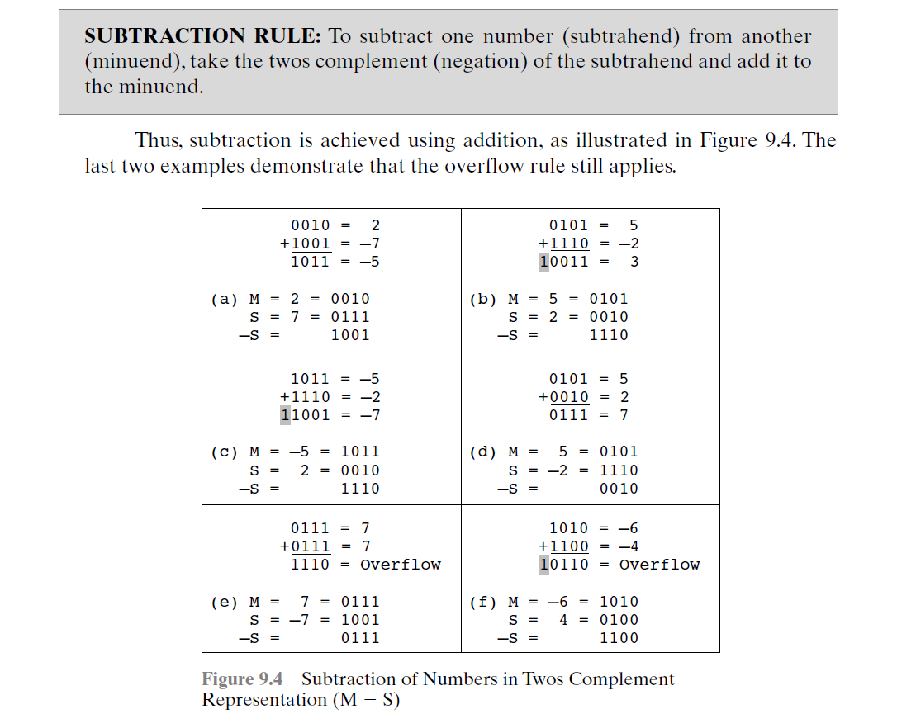

Slide 17
Addition and Subtraction
Normal binary addition
Monitor sign bit for overflow
Take twos compliment of substahend and add to minuend
— i.e. a - b = a + (-b)
So we only need addition and complement circuits
A | B | Sum
0 | 0 | 0
0 | 1 | 1
1 | 0 | 1
1 | 1 | 0, Carry 1
1 | 1 | 1,Carry 1

Slide 18
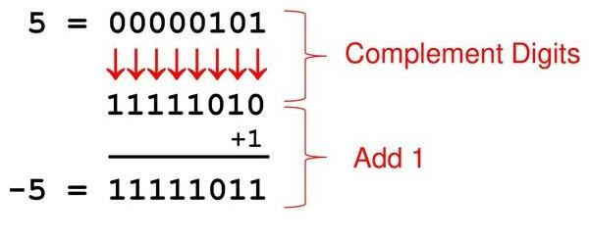
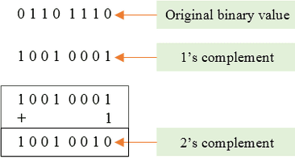
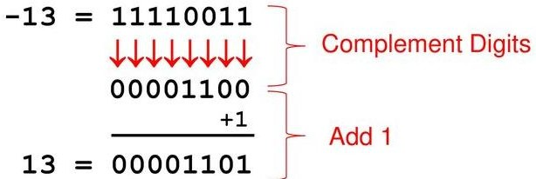
Example of 2’s Compliment

Slide 19
Find 2’s compliment
1000
0100
111001
101010
100000

Slide 20
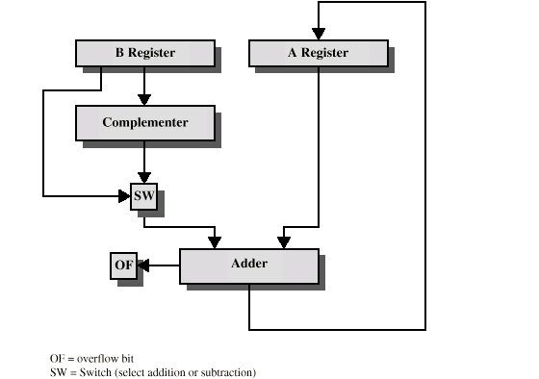
Hardware for Addition and Subtraction

Slide 21
data paths and hardware elements needed to accomplish addition and subtraction.
The central element is a binary adder, which is presented two numbers for addition and produces a sum and an overflow indication.
The binary adder treats the two numbers as unsigned integers.
For addition, the two numbers are presented to the adder from two registers, designated in this case as A and B registers.
The result may be stored in one of these registers or in a third.
The overflow indication is stored in a 1-bit overflow flag.
For subtraction, the subtrahend (B register) is passed through a twos complementer so that its twos complement is presented to the adder
Control signals are needed to control whether or not the complementer is used, depending on whether the operation is addition or subtraction.

Slide 22
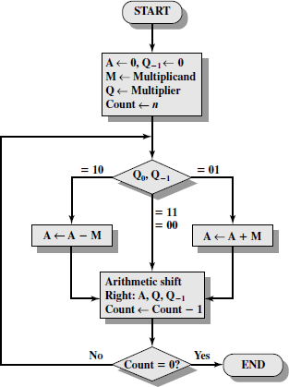
Booth’s Algorithm

Slide 23
Q0 | Q-1 | Result
0 | 0 | Only shift
1 | 1
0 | 1 | A=A + M ,then shift
1 | 0 | A= A – M , then shift
M =7
Q =3
M = 0 1 1 1
Q = 0 0 1 1
- M = 1 0 0 1

Slide 24




Example of Booth’s Algorithm:7(M)*3(Q)
Answer is in A and Q→0001 0101 =21

Slide 25
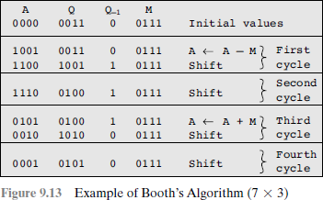

Slide 26
Examples-size of n determines answer
Solve using Booths Algorithm A. M = 5 , Q = 5
B. M = 12, Q = 11
C. M = 9, Q = - 3
D. M = -13 ( 0011 ) , Q = 6
-M=13 (1101)
A. M = -19 , Q = -20

Slide 27
Division
More complex than multiplication
Negative numbers are really bad!
Based on long division

Slide 28
Division of Unsigned Binary Integers
00001101 1011 10010011
Quotient
Dividend
Divisor
1011
001110
1011
Partial Remainders
001111
1011
100
Remainder

Slide 29
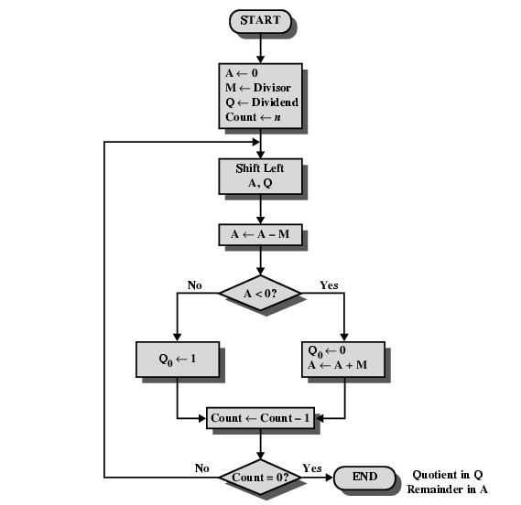
Flowchart for Restoring Division

Slide 30
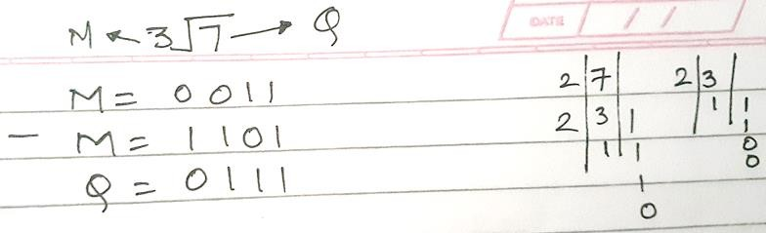
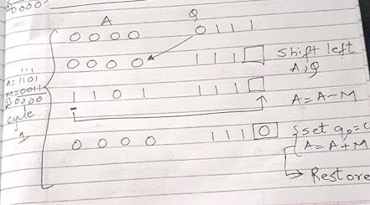

Slide 31
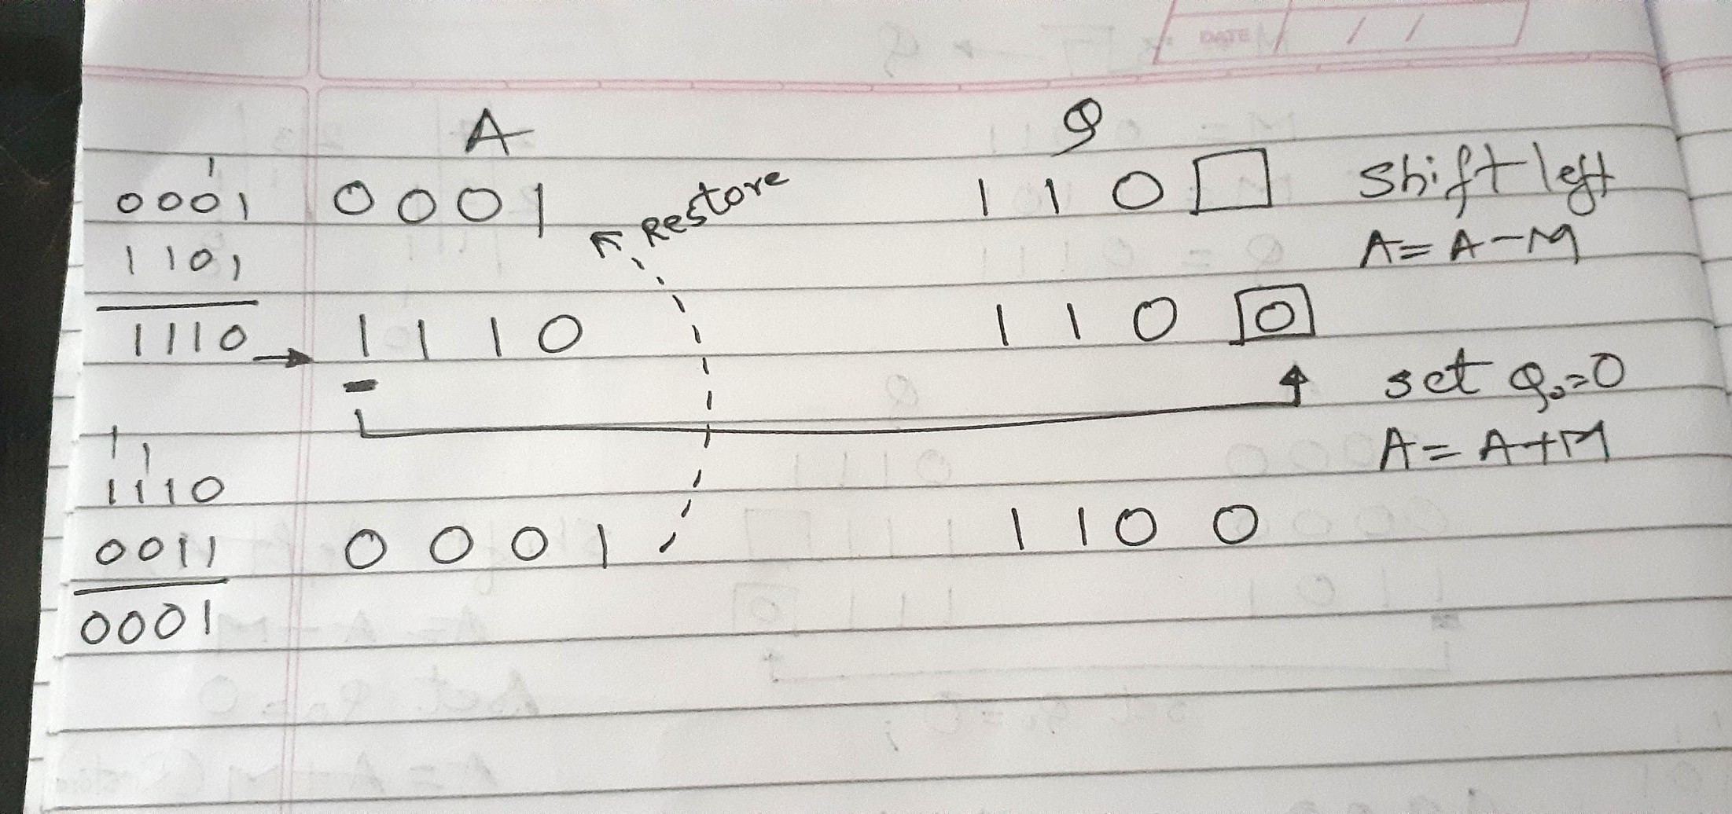

Slide 32
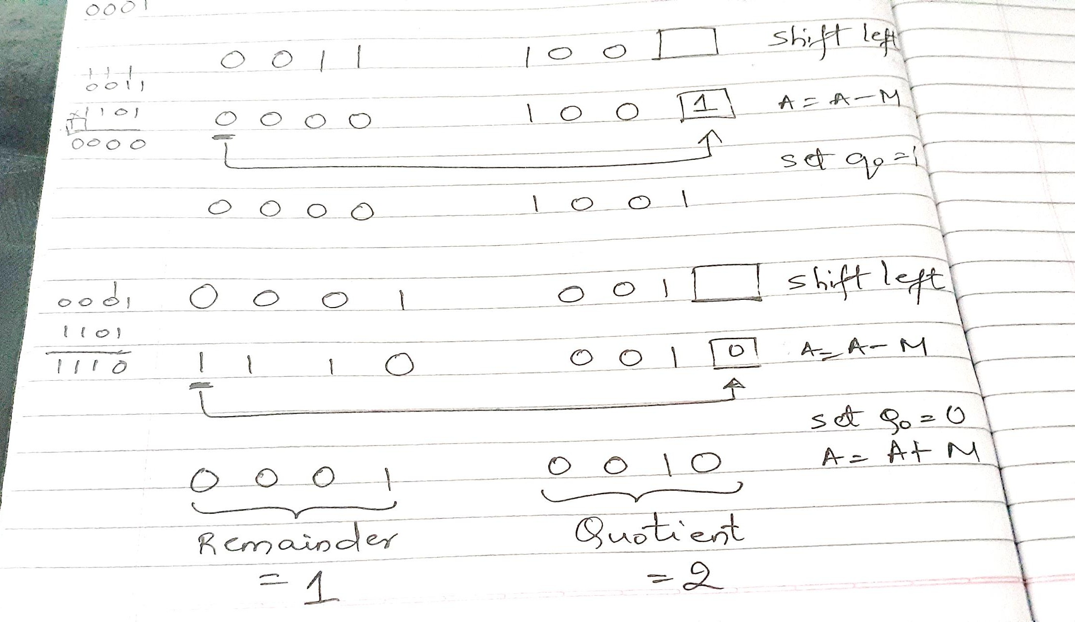

Slide 33
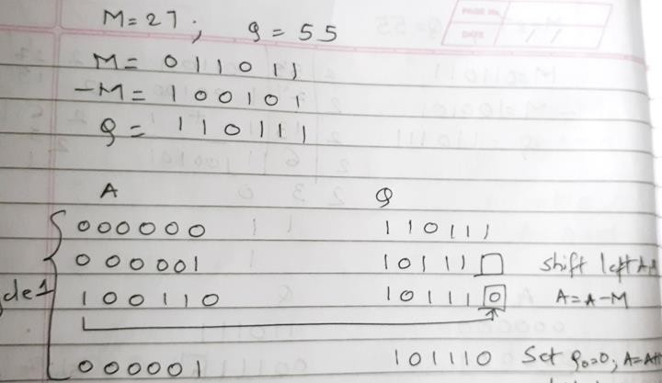

Slide 34
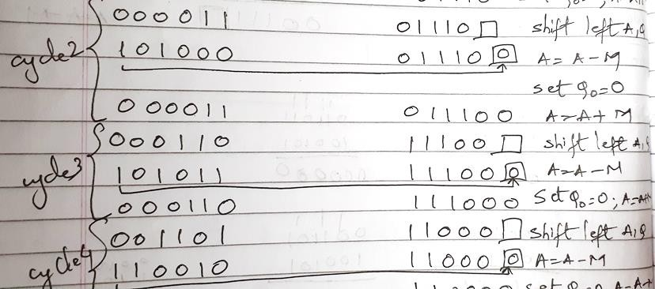

Slide 35
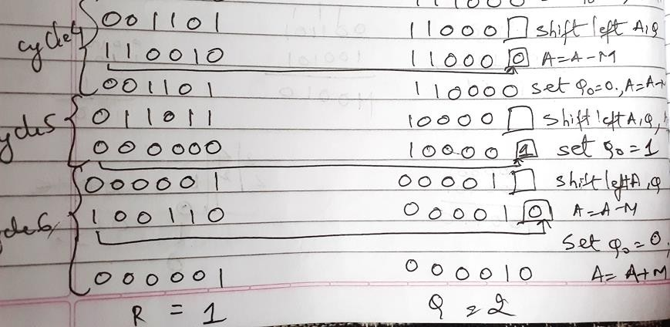

Slide 36
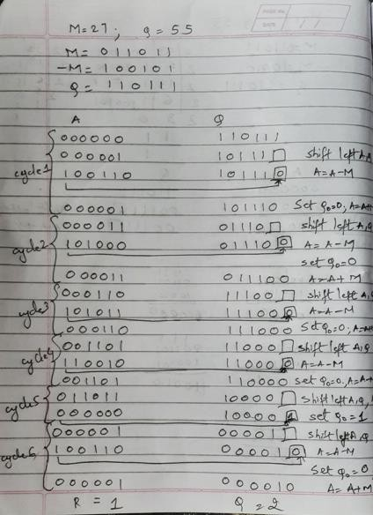

Slide 37
Solve using Restoring Division
A. M = 5 , |  | Q = 5 , A=0000 , Q=0010
B. M = 12, |  | Q = 26, A=00010 , Q= 00010
C. M = 9, |  | Q = 19 , A=00001 , Q =00010
D. M = 32 | , | Q = 59, A=011011, Q=000001
E. M = 17 | , | Q = 42, A=001000 , Q=000010

Slide 38
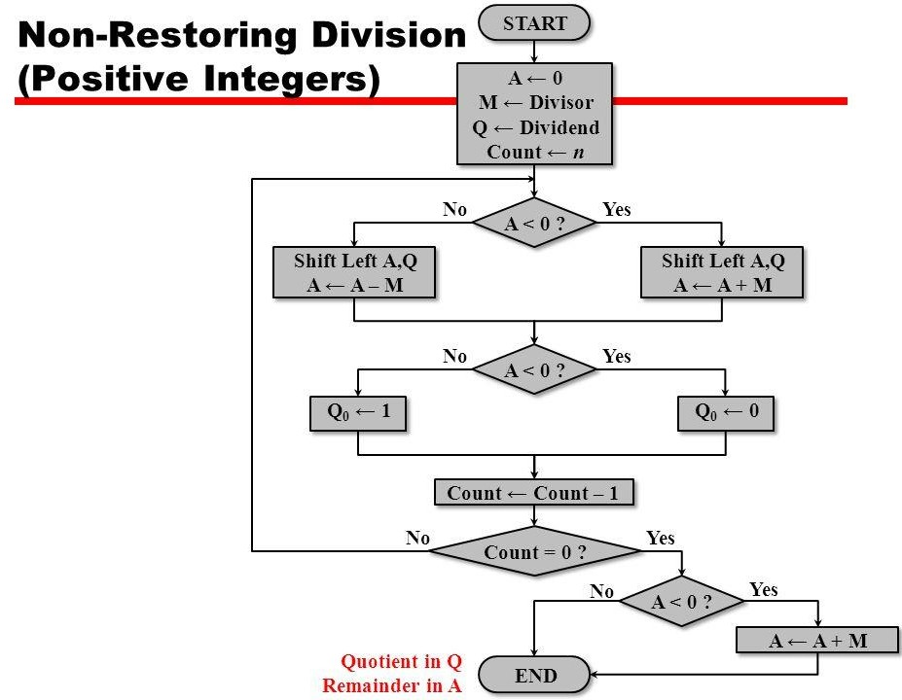

Slide 39
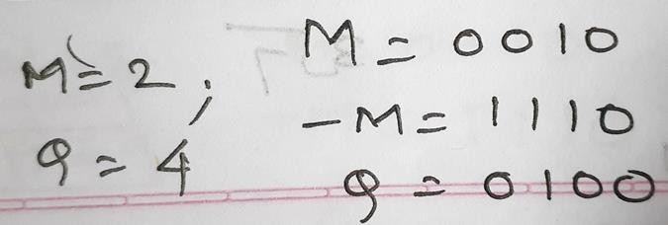
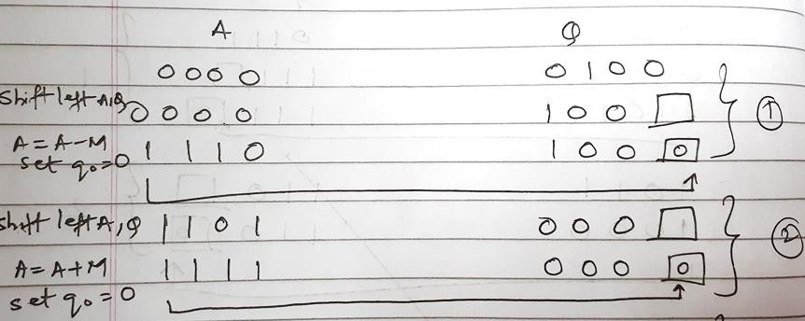

Slide 40
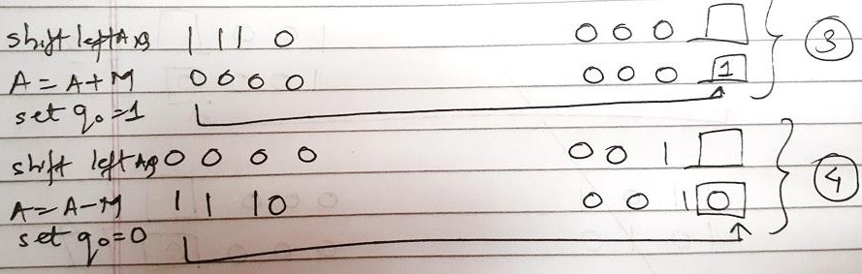
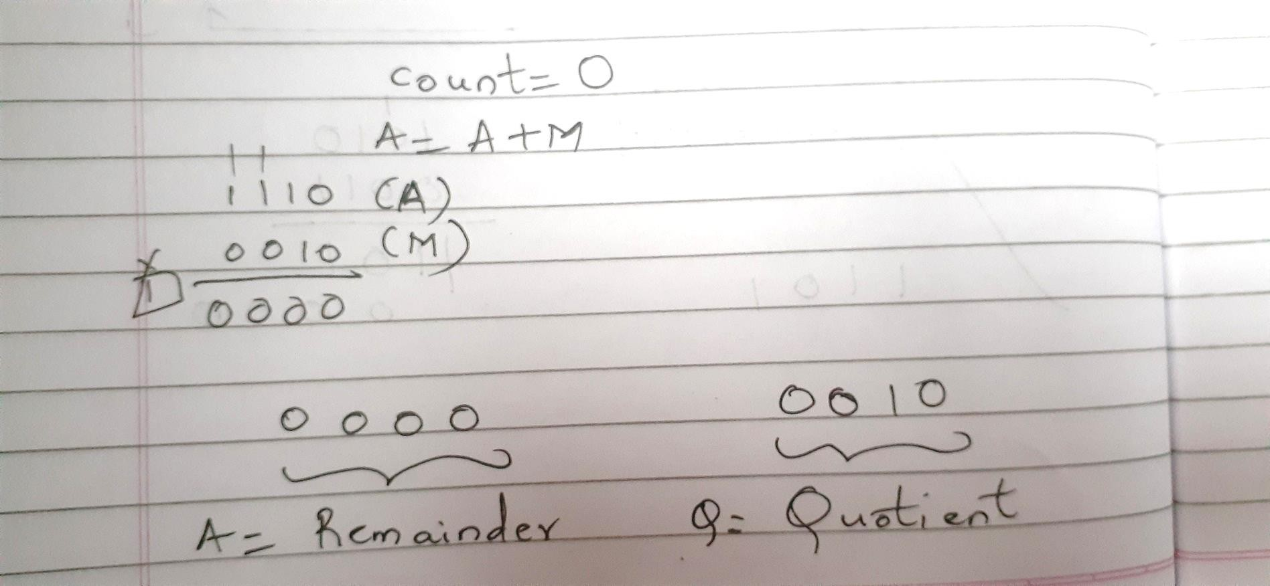

Slide 41
Solve using Non Restoring
A. M = 5 , |  | Q = 5,A=0000,Q=0001.
B. M = 12, |  | Q = 26,A=000010, Q=000010.
C. M = 9, |  | Q = 19,A=00001,Q=00010.
D. M = 32 | , | Q = 59,A=011011,Q=000001.
E. M = 17 | , | Q = 42,A=001000,Q=000010

Slide 42
Booths Recoding / Bit pair recording
STEPS

Slide 43
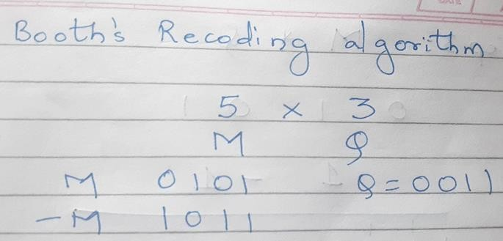

Slide 44
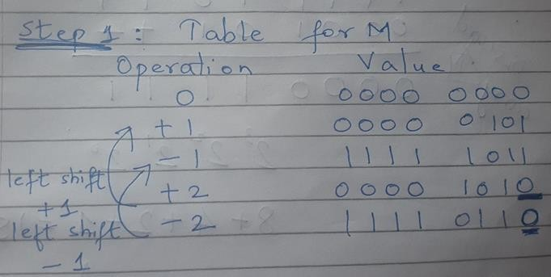

Slide 45
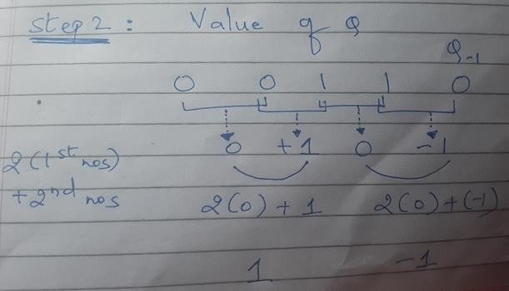

Slide 46
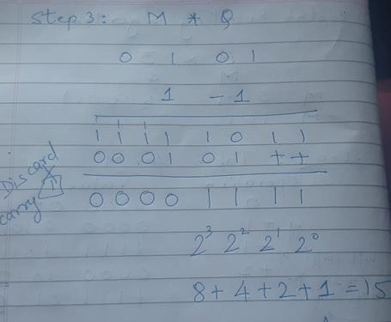

Slide 47
Solve using Booths Recoding
1. M= 5 , Q = 4 (4 bits)= 00010100 (20)
2. M=9 , Q = -6 (5 bits)=11110 01010 (-54)
3. M=15 , Q=-10 (5 bits)=11011 01010(-150)
4. M= -13 ,Q = -20 (6 bits )=000100000100(260)

Slide 48
Sample mix problems-Kindly refrain referring to flowchart.
1. Booth’s Algorithm = 000 100 000 100(260)
A= 110011 (Multiplicand ) B= 101100 (Multiplier)
2. Booth’s Recoding = 0110 1010/11011 01010
M= ( 15 ) Q= ( -10 )
Non Restoring Division
M=11 , Q= 21 , A= 01010 , Q= 00001
Restoring Division
M=14 , Q= 15, A=00001 , Q = 00001

Slide 49
Floating Point
Sign bit | Biased Exponent | Significand or Mantissa
• A floating point number, is a positive or negative whole number with a decimal point. For example, 5.5, 0.25, and -103.342 are all floating point numbers, while 91, and 0 are not
+/- .significand x 2^{exponent}
Misnomer
Point is actually fixed between sign bit and body of mantissa
Exponent indicates place value (point position)

Slide 50
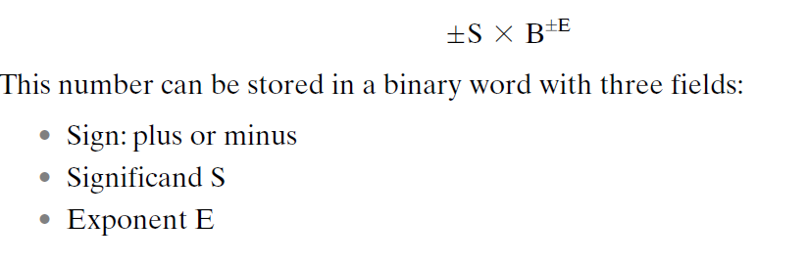

Slide 51
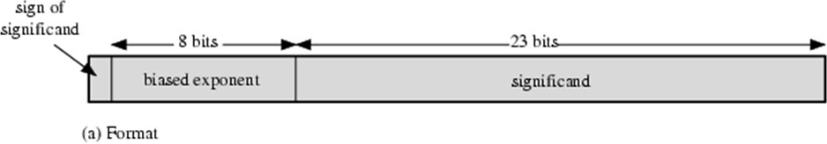
Floating Point Examples
Typical 32-Bit Floating-Point Format
The leftmost bit stores the sign of the number
The exponent value is stored in the next 8 bits.
The representation used is known as a biased representation.
A fixed value, called the bias, is subtracted from the field to get the true exponent value.

Slide 52

A fixed value, called the bias, is subtracted from the field to get the true exponent value. Typically, the bias equals where k is the number of bits in the binary exponent.
In this case, the 8-bit field yields the numbers 0 through 255.
With a bias of 127 (2^7-1), true exponent values are in the range -127 to 128. In this example, the base is assumed to be 2.
A normalized number is one in which the most significant digit of the significand is nonzero. For base 2 representation, a normalized number is therefore one in which the most significant bit of the significand is one

Slide 53
Signs for Floating Point
Mantissa is stored in 2s compliment
Exponent is in excess or biased notation
—e.g. Excess (bias) 128 means
—8 bit exponent field
—Pure value range 0-255
—Subtract 128 to get correct value
—Range -128 to +127

Slide 54
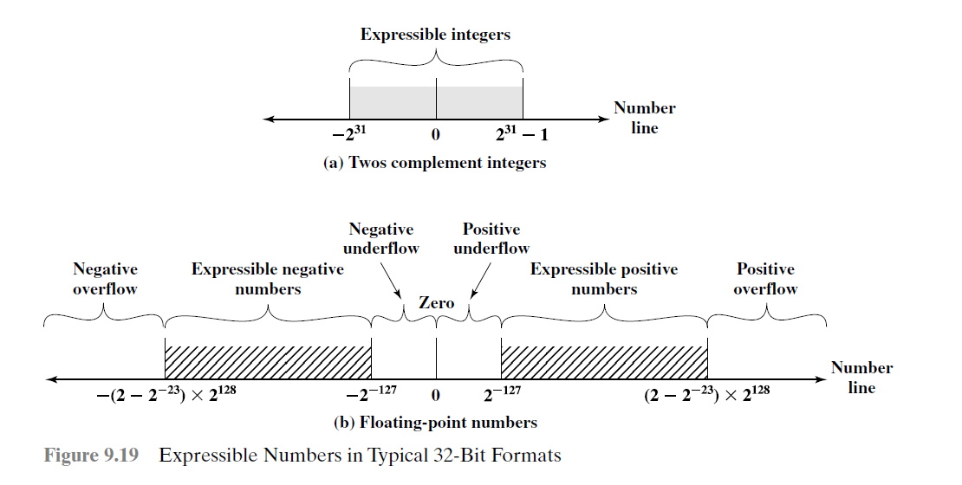
Expressible Numbers

Slide 55

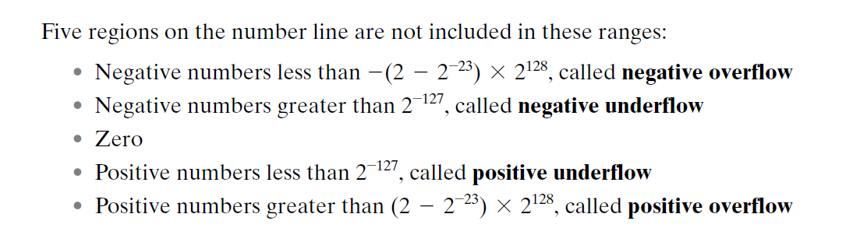
Overflow occurs when an arithmetic operation results in a magnitude
greater than can be expressed with an exponent of 128.
Underflow occurs when the fractional magnitude is too small

Slide 56
IEEE 754
Standard for floating point storage
developed to facilitate the portability of programs from one processor to another
Defines 32 and 64 bit standards with 8 and 11 bit exponent respectively
the standard defines two extended formats, single and double, whose exact format is implementation dependent.
The extended formats include additional bits in the exponent (extended range) and in the significand (extended precision).
The extended formats are to be used for intermediate calculations.
Extended formats (both mantissa and exponent) for intermediate results

Slide 57
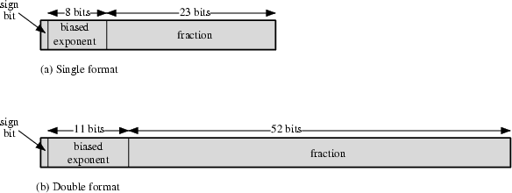
IEEE 754 Formats
(1.N)2^{E-127}
32 BIT
64 BIT
_{(1.N)2}E-1023

Slide 58
Steps
1. Convert Decimal to Binary
2. Normalization
— Rewriting Step 1 into (1.N) form
— Ex: 1 1 1 . 0 1 1 = 1 . 1 1 0 1 1 X 2 ²
Exponent
— Ex: 0 . 0 0 0 1 0 = 0 0 0 0 1 . 0 X 2 -⁴
3.Biasing
— Applying Single Precision (E – 1 2 7) & Double Precision ( E – 1 0 2 3 ) on exponent from Step 2
4. Representation in Single (32 bit )and Double Precision (64 bit ) Format

Slide 59
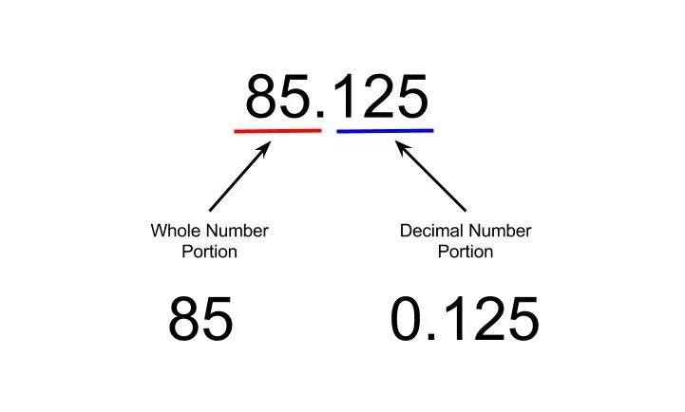
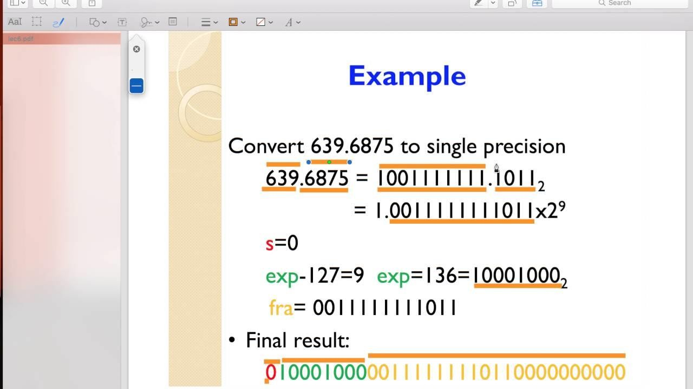

Slide 60
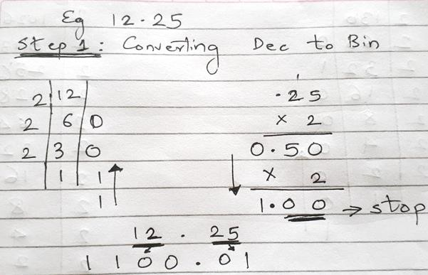
Solved Example

Slide 61
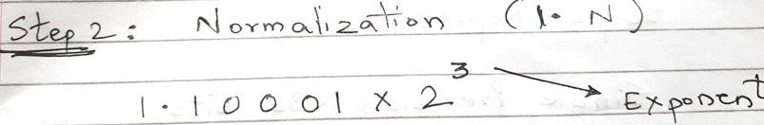
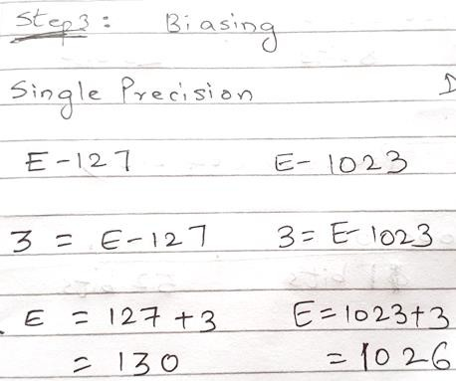


Slide 62
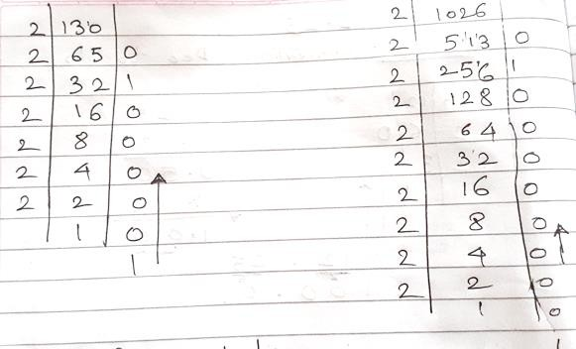

Slide 63
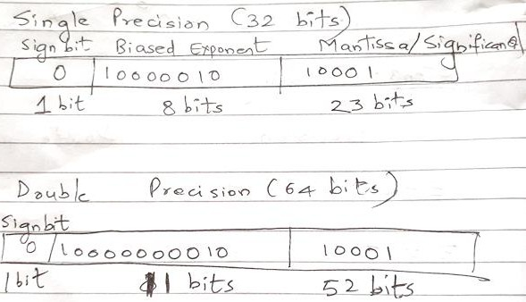

Slide 64
Solve
25.44
SP- 0|100000|1001 0111 0000 1010 0011 110
DP- 0|10000000011|1001 0111 0000 1010 0011 110
0.00635
SP- 0|1110111|00000001101000…
DP- 0|1111110111|00000001101000… SP- 1 | 10000101| 1111 010001
DP- 1 | 10000000101| 1111 010001
-125.10
-13.54
SP- 1|10000010|10110001010
DP- 1|10000000010|10110001010

Slide 65
Sample Problems to Solve
1) 178.1875
SP 0|10000110|01100100011 DP 0|10000000110|
1) 309.175
SP 0|10000111|01011101001011 DP 0|10000000111|
1) 1259.125
SP 0|10001001|0011101011001000…(9 zeroes) DP 0|10000001001|010100111100
1) 0.0625
SP 0|01111011|0000000…. DP 0|01111111|00000…..

Slide 66
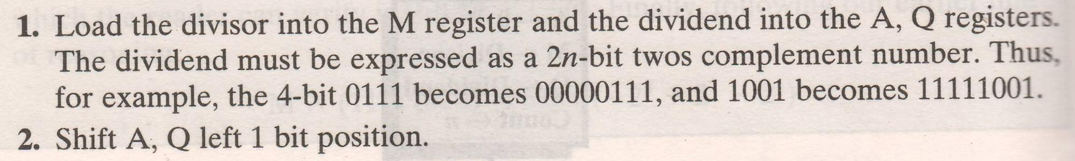
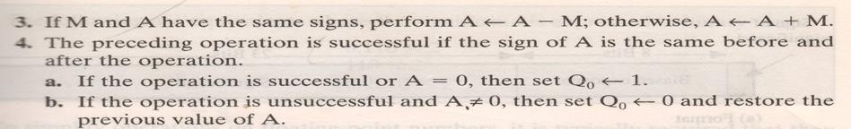

Division of signed numbers

Slide 67
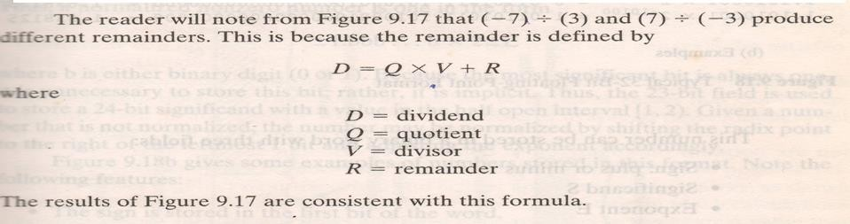

Slide 68


Slide 69
Solve
a) 7 / -3
b) -7 (Q) / 3 (M)
c) -7 (Q) / -3 (M)

Slide 70


Slide 71



Slide 72


Slide 73
Dividend negative → Remainder –ve

Slide 74


Slide 75


Slide 76
4 phases of FP Arithmetic +/-
Check for zeros
Align significands (adjusting exponents)
Add or subtract significands
Normalize result

Slide 77
Floating Point Addition
Add the following two decimal numbers in scientific notation:
8.70 × 10⁻¹ with 9.95 × 10¹
Rewrite the smaller number such that its exponent matches with the exponent of the larger number.
8.70 × 10⁻¹ = 0.087 (Note ! ) × 10¹

Slide 78
Add the mantissas
9.95 + 0.087 = 10.037 and
write the sum 10.037 × 10¹
Put the result in Normalised Form 10.037 × 10¹ = 1.0037 × 10²
(shift mantissa, adjust exponent)

Slide 79
Check for overflow/underflow of the exponent after normalisation
Overflow
The exponent is too large to be represented in the Exponent field
Underflow
The number is too small to be represented in the Exponent field

Slide 80
Round the result
If the mantissa does not fit in the space reserved for it, it has to be rounded off.
For Example: If only 4 digits are allowed for
mantissa
1.0037 × 10² ===> 1.004 × 10²

Slide 81

FP Addition & Subtraction Flowchart

Slide 82
FP Arithmetic x/÷
Check for zero
Add/subtract exponents
Multiply/divide significands (watch sign)
Normalize
Round
All intermediate results should be in double length storage

Slide 83

Floating Point Multiplication

Slide 84

Floating Point Division

